Slide 1


Mutation Rate Analysis and Gene Engineering
24AIM112 and 24AIM115
Team Members:
C M Prakateessh CB.AI.U4AIM24110
Mahashree C CB.AI.U4AIM24128
Reha Sreekumar CB.AI.U4AIM24146
Susanth Mohan Kamala CB.AI.U4AIM24148
Guide:
Dr. Kelath Murali Manoj
Mrs. Reshma sanal
Dr. Neelesh Ashok
1

Slide 2
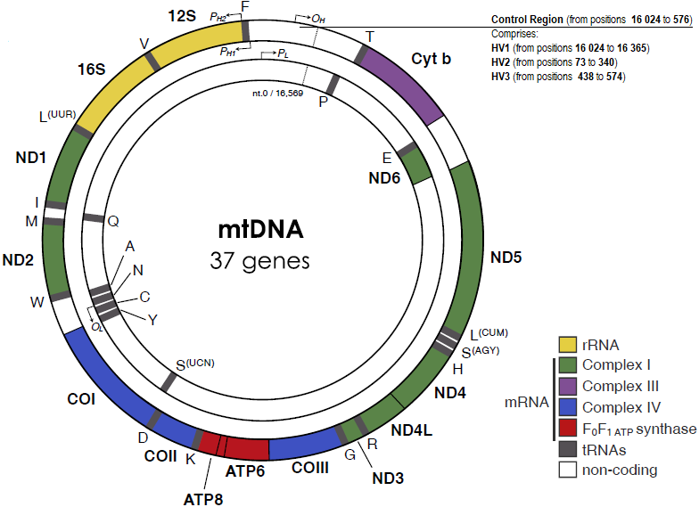
Introduction
Mutation rates influence gene stability, evolution, and genetic diversity.
High mutation rates can lead to genetic disorders and reduced gene functionality.
Understanding mutation patterns helps predict gene stability.
2

Slide 3


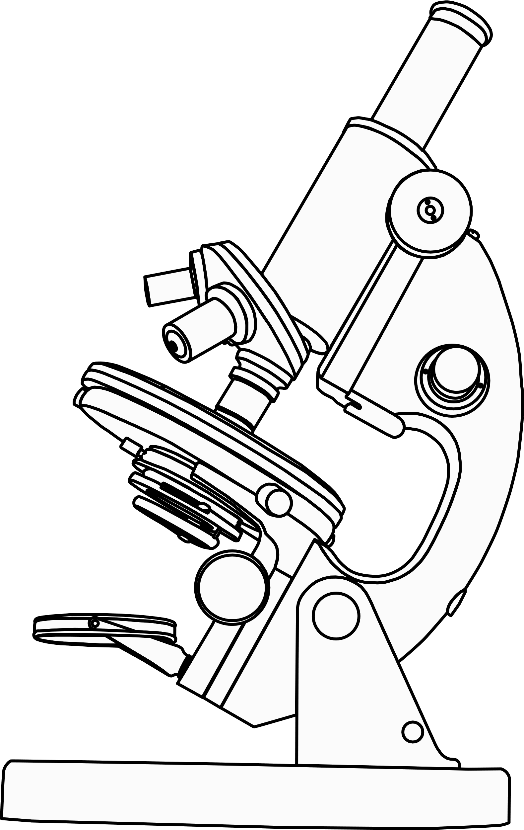
Objective
To compare the mutation rates among 15 different species of mitochondrial gene.
To identify unstable genes and perform gene editing to enhance stability.
Predicting the Gene Stablility
3

Slide 4
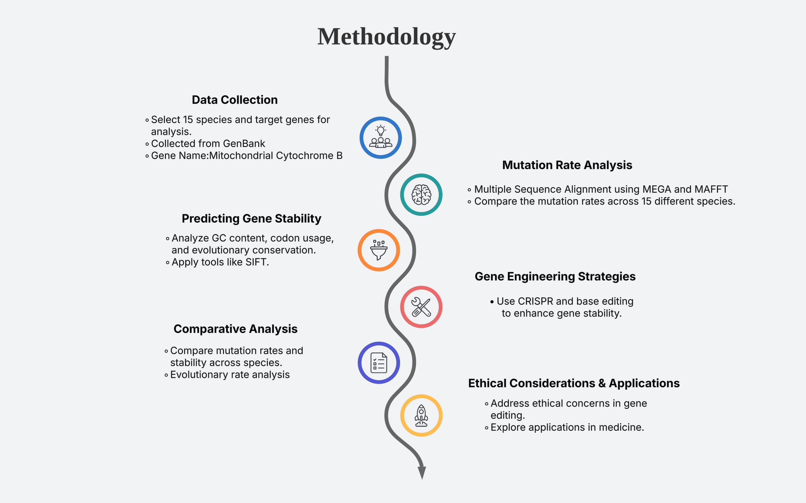
4

Slide 5

What did we do?
5

Slide 6
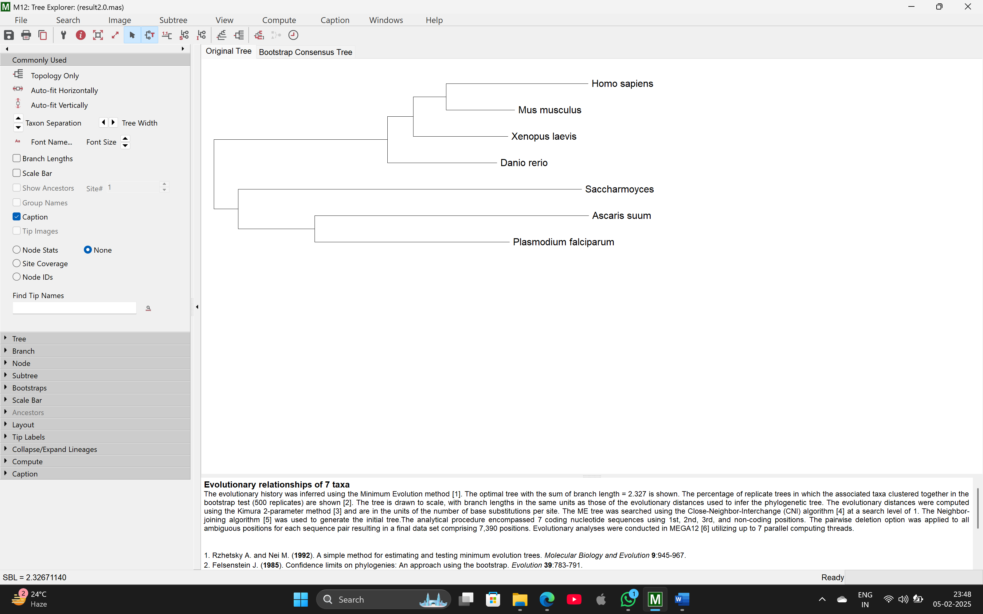
Phylogenetic Tree
6

Slide 7
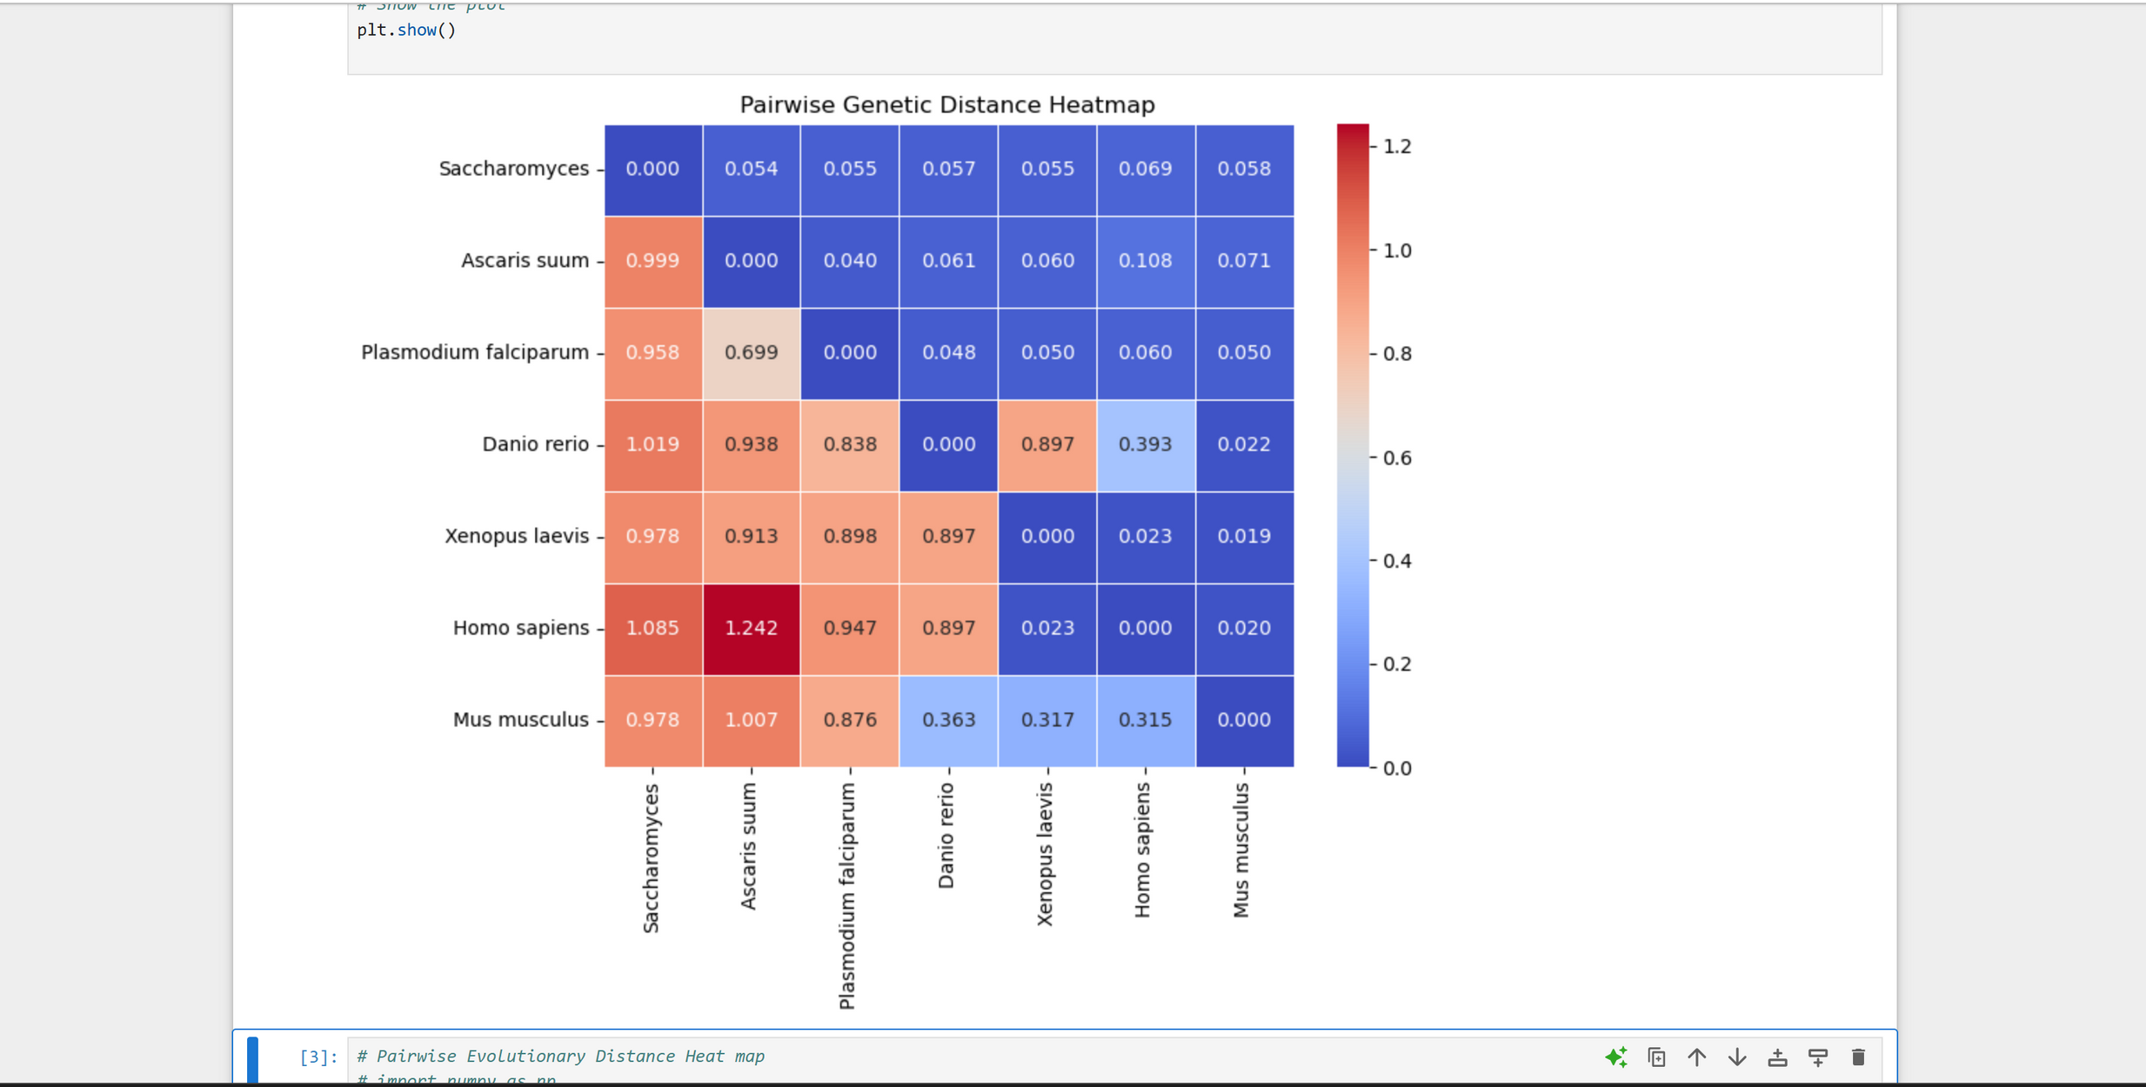
Confusion Matrix of Mutation Rate Analysis
7

Slide 8
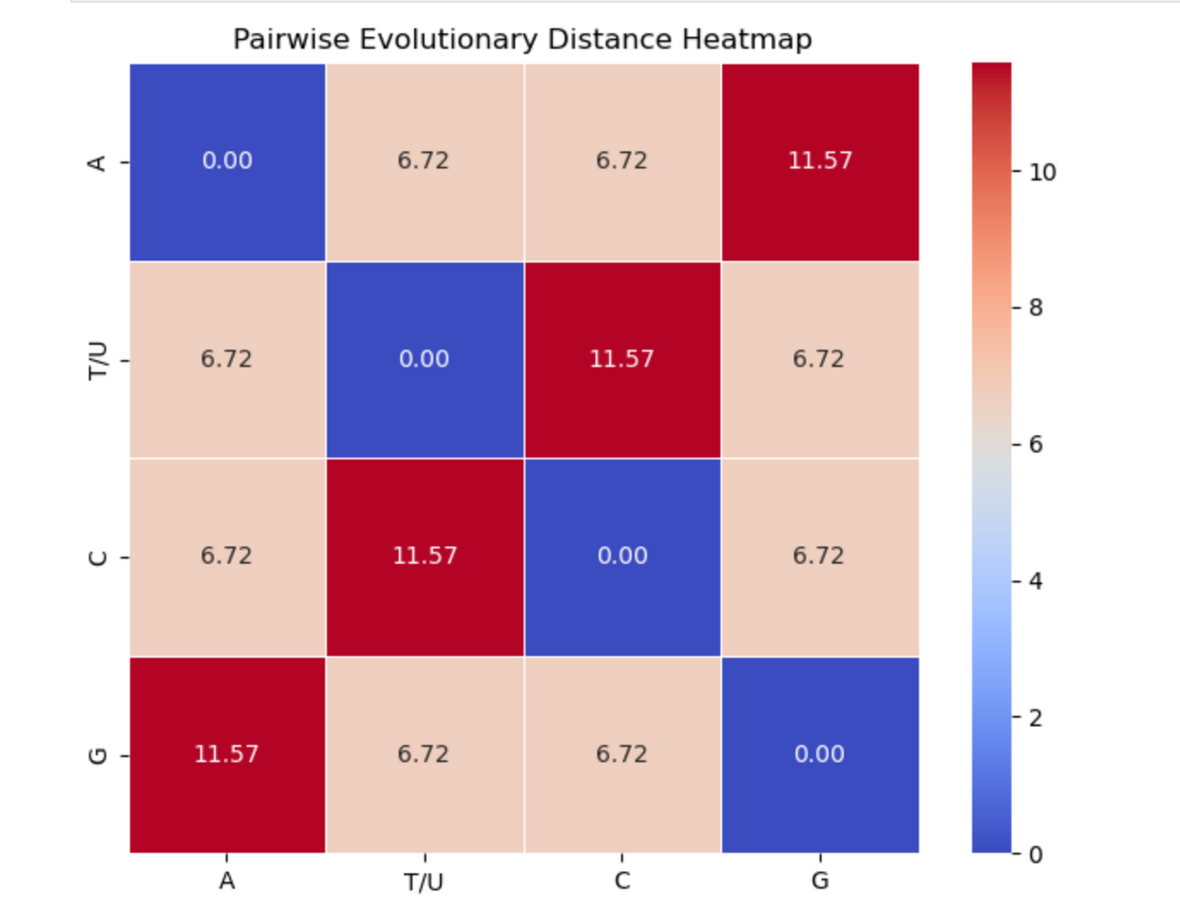
Confusion Matrix of Evolutionary Rate Analysis
8

Slide 9
Update
9

Slide 10
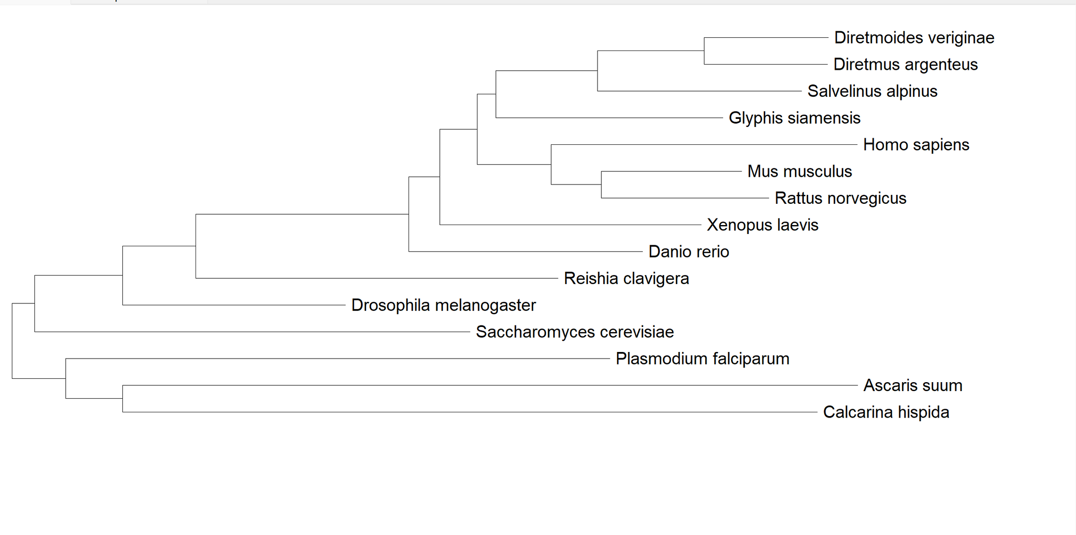
Phylogenetic Tree
10

Slide 11
Confusion Matrix of Mutation Rate Analysis
11

Slide 12
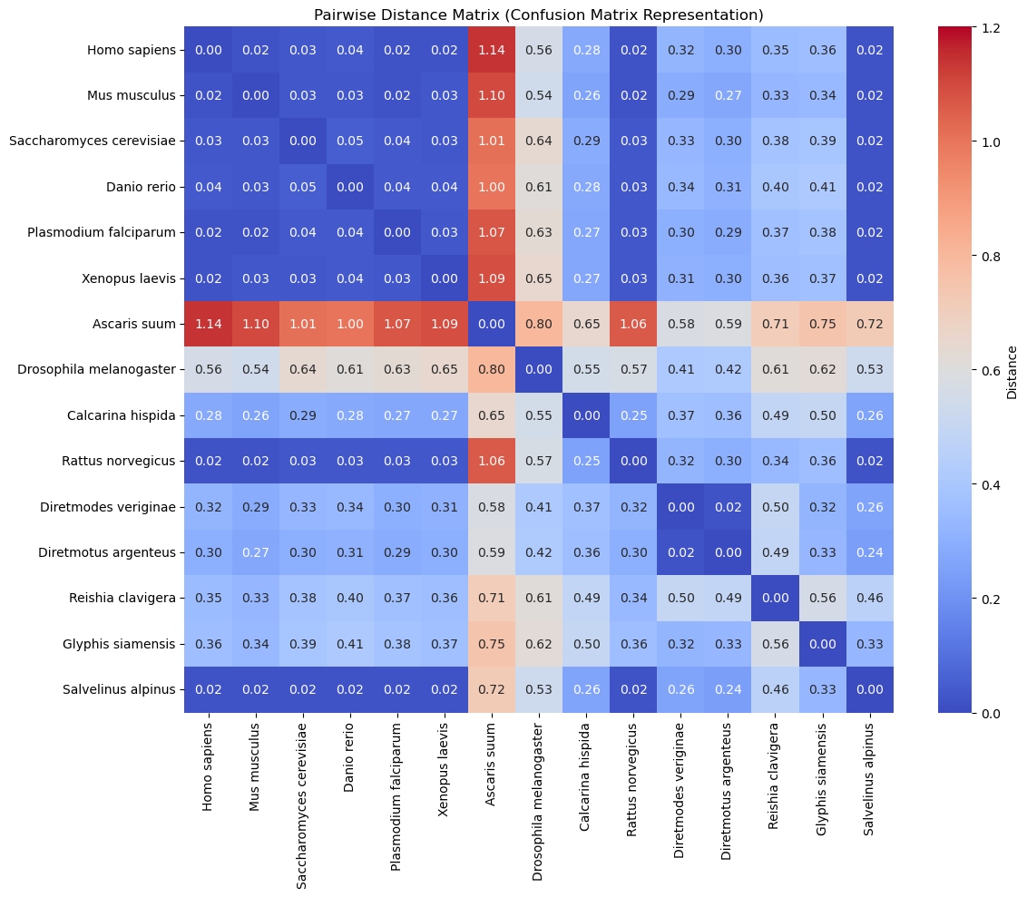
12

Slide 13
Confusion Matrix of Evolutionary Rate Analysis
13

Slide 14
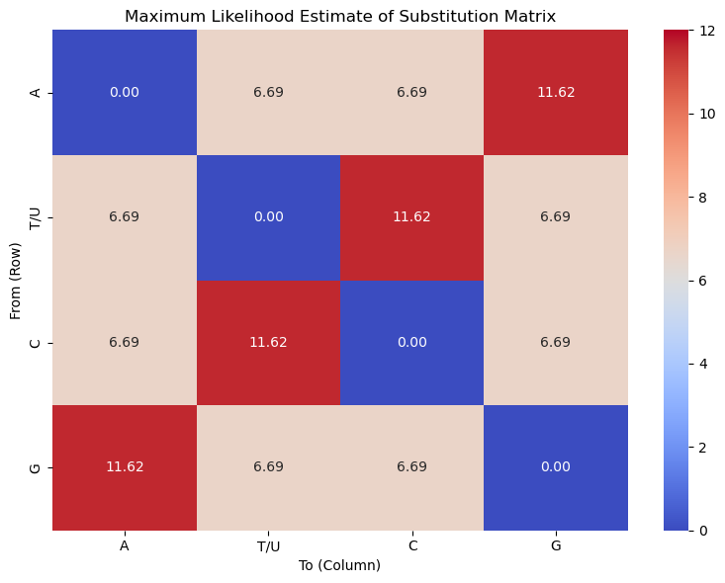
14

Slide 15
Predicting Gene Stability
15

Slide 16
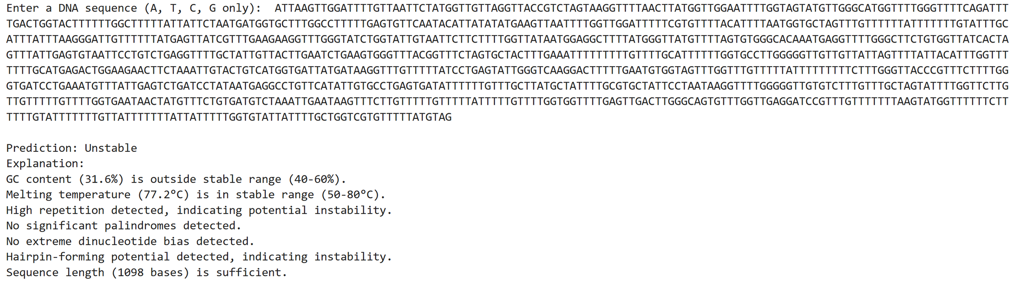
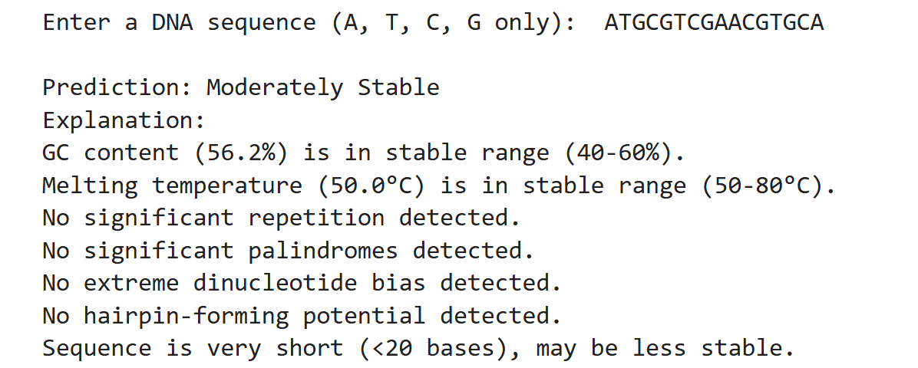
16

Slide 17

User Interface for Predicting Gene Stability
Gene Stability Predictor ext
17

Slide 18
Gene Editing {CRISPR}
18

Slide 19
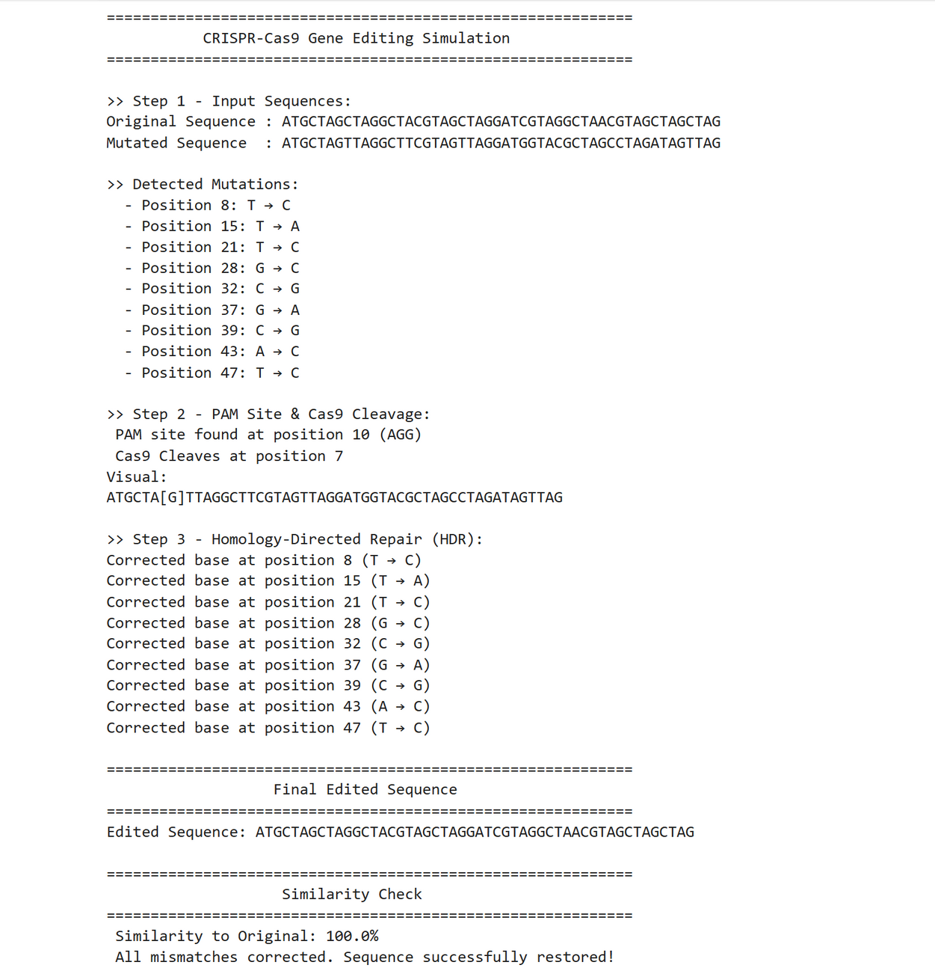
19

Slide 20
Role of Ethics
Ensuring Responsible Gene Editing. [Designer babies]
Avoiding Unintended Consequences. [Chinese scientist]
Regulatory Compliance Balancing Scientific Progress and Moral Values.
[Human cloning]
Preventing Genetic Discrimination. [Insurance company]
Transparency and Public Trust.
Environmental and Biodiversity Considerations. [Mosquitoes]
20

Slide 21
Case Studies
CRISPR-Cas9 Gene Editing for Sickle Cell Disease and β-Thalassemia [2020]
He Jiankui’s CRISPR Babies Experiment [2018]
Embryo Screening for Intelligence [2024]
Genetically Modified Pets (Glowing Rabbits) [2025]
21

Slide 22
IPR
Methods and materials for making and using transgenic dicamba-degrading organisms.
Patent Number: US20150368683A1
2. CRISPR-Cas Systems and Methods for Altering Expression of Gene Products
Patent Number: US8697359B1
22

Slide 23

Conclusion
This project highlights the importance of mutation rate analysis in understanding gene stability across species. By leveraging computational models, we identified mutation rates and predicted gene resilience.
Gene engineering techniques, such as CRISPR, to stabilize genes and minimize harmful mutations, with potential applications in medicine.
Ethical considerations remain crucial, ensuring responsible use of genetic modifications while addressing concerns related to unintended consequences and biodiversity impact. This project offers insights into evolutionary biology and future genetic innovations.
23

Slide 24
THANK
YOU!
24

